Slide 1

Intro Presentation in the heart.dk Network and register information's
Mikkel Porsborg Andersen
Ph.D, MSc.Public Health, BSc.Sports Science
Senior researcher and Datamanager
Nordsjællands Hospital
E-mail: mikkel.porsborg.andersen@regionh.dk

Slide 2
Overview
The Heart.dk network setup at Statistics Denmark DST
Github
Github demo
The Danish Setting
Information on registries and variables
“Tell me and I forget, teach me and I may remember, involve me and I learn.”
Benjamin Franklin
Slide 1 of 16

Slide 3
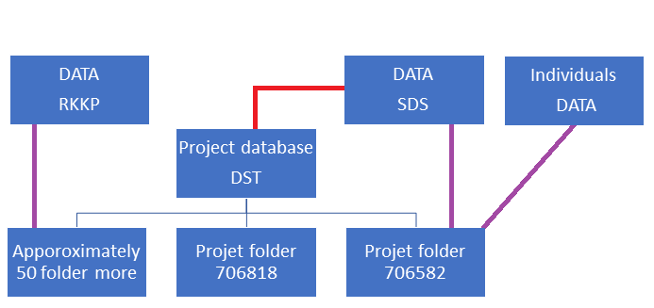
The Heart.dk network setup at Statistics Denmark DST
Approximately 250 users
Project folder structure
Data flow
Folder population
Reduce data
Github
Slide 2 of 16

Slide 4
Github
Project descriptions of project folder
Updates on project folder
Different guides in relation to the Heart.dk setup at DST
Dynamic update
Demo on the information available
Link to Heart.dk and Github
Heart.dk
Github
Slide 3 of 16

Slide 5
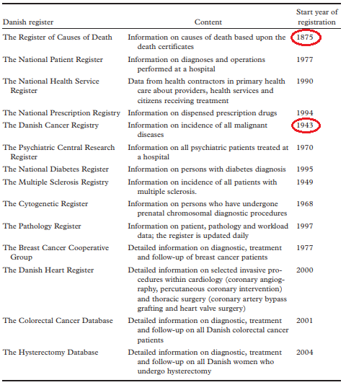
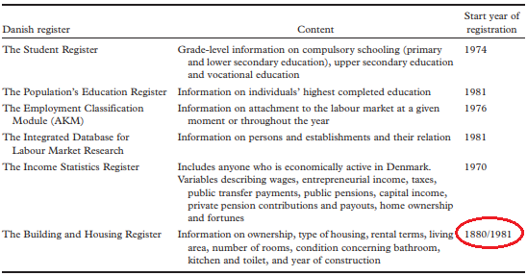
Danish Setting
Denmark if often referred to as one big cohort
Long history of collecting data on the population
Slide 4 of 16
https://journals.sagepub.com/doi/pdf/10.1177/1403494811399956

Slide 6
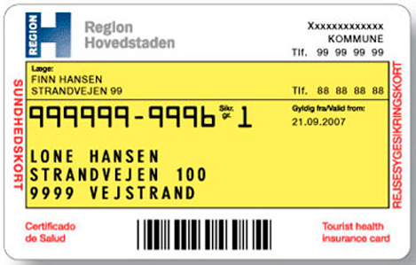
Danish Setting
An important and unique factor in the Danish setting was the introduction of the Civil Registration Number (CPR) in 1968
All Danish resident are assigned a personal Civil Registration Number (CPR) at birth or upon immigration
Slide 5 of 16

Slide 7
Danish Setting
The CPR-number is used for administrative purposes
Healthcare card/Yellow health card
The CPR-number makes it possible to link data from the different health- and administrative registries to an individual
Slide 6 of 16

Slide 8
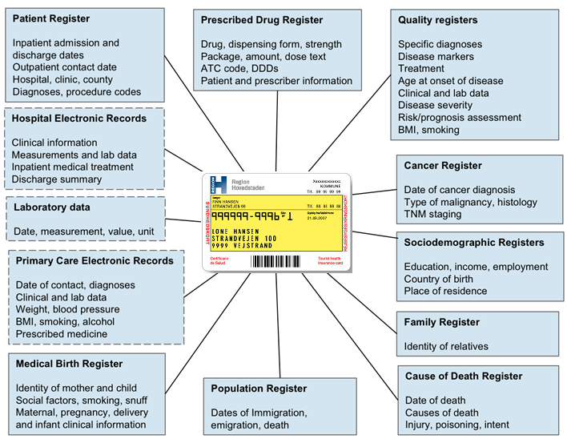
Danish Setting
Different registries hold different information
However, some variables might be in multiple registries e.g., date of death, sex, age, identity of mother/dad and child
Slide 7 of 16

Slide 9
Danish Setting
Important to check where the variables originated from and its purpose in the registry as they could have an affect in the study to be conducted
For instance, the identity variable of the mother/dad and child may not be the same in Medical Birth register and Population register
Slide 8 of 16

Slide 10
Danish Setting
There are two organizations that handles the Danish registries
Statistics Denmark (DST) and The Danish Health Data Authority (SDS)
Both organizations can provide researchers with remote access to Danish registries data
Pros and cons
Health- vs. administrative registries
Slide 9 of 16

Slide 11

Danish Setting
The Danish Health Data (SDS) has the legal authority over the health registries
Through SDS it is possible to get access to the newest update versions that are available
Slide 10 of 16

Slide 12
Danish Setting
The Statistics Denmark (DST) has the legal authority over the administrative registries
Transfer of register-data between DST and SDS
SDS is required to sent a copy of the health registries to DST annually by law, but this does not apply the opposite way for DST
No socioeconomic status variable is available
Slide 11 of 16

Slide 13
Information on registries and variables
Registre descriptions
Variable descriptions
Datasource dependent
Links to informations on variables from:
The Danish Health Data Authority (SDS)
Statistics Denmark (DST)
The regions’ clinical quality development program (RKKP)
Slide 12 of 16

Slide 14
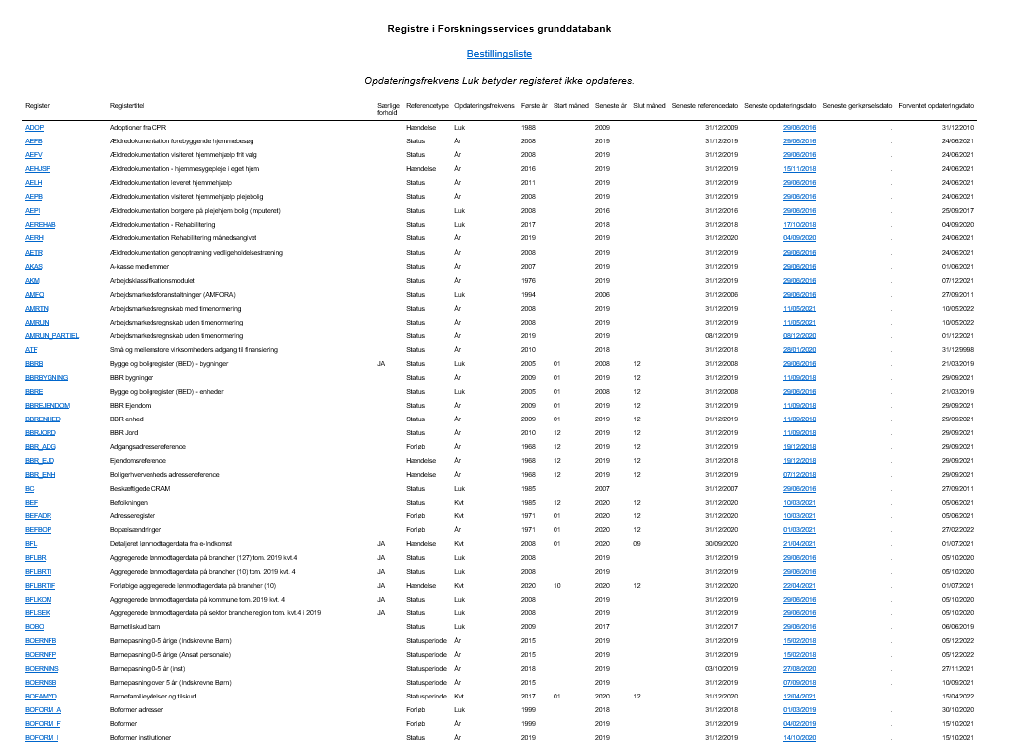
Statistics Denmark (DST)
Overview of registries at DST
Information on each registry
Important links below:
Registries in Forskningsservice grunddatabank
Documentation
Slide 13 of 16

Slide 15
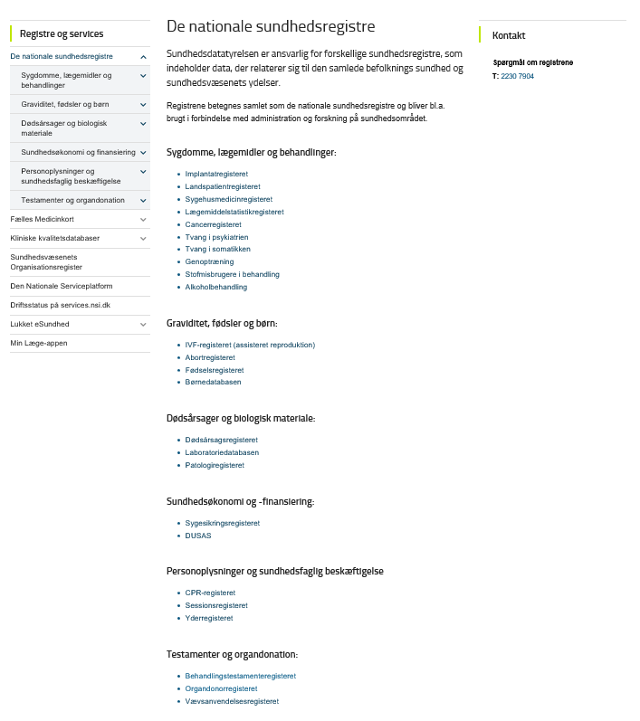
The Danish Health Data Authority (SDS)
Overview of registries at SDS
Information on each registry
Important links below:
The national health registries
Documentation
Important links below:
The Danish National Patient Register (LPR2)
The Danish National Patient register – temporary data model (LPR3_SB)
Slide 14 of 16

Slide 16
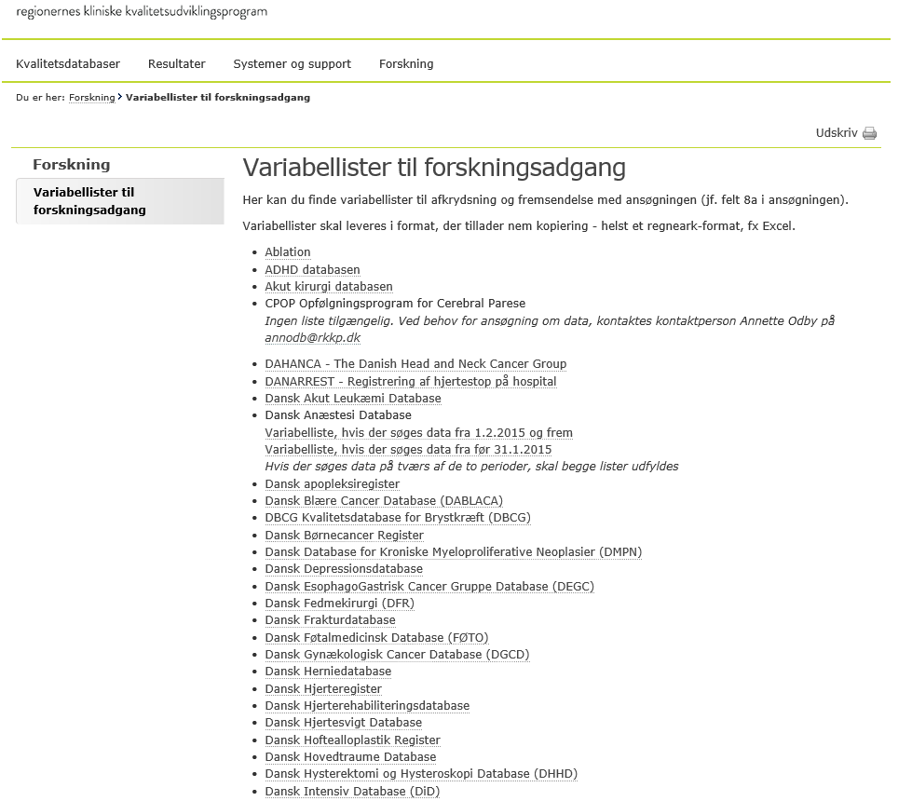
The regions’ clinical quality development program (RKKP)
Overview of database at RKKP
Information on each database
Important links below:
Clinical quality databases
Documentation
Slide 15 of 16
https://www.rkkp.dk/forskning/variabellister-til-forskningsadgang/

Slide 17

Questions or comments
Slide 16 of 16

